Slide 1
Modelling Unmanned Aerial Swarms Using Unreal Game Engine and AirSim Simulator
Project Team: Naimah-Joy Chapman, Elijah Keck, Dillion Mead, and John Mueller

Slide 2
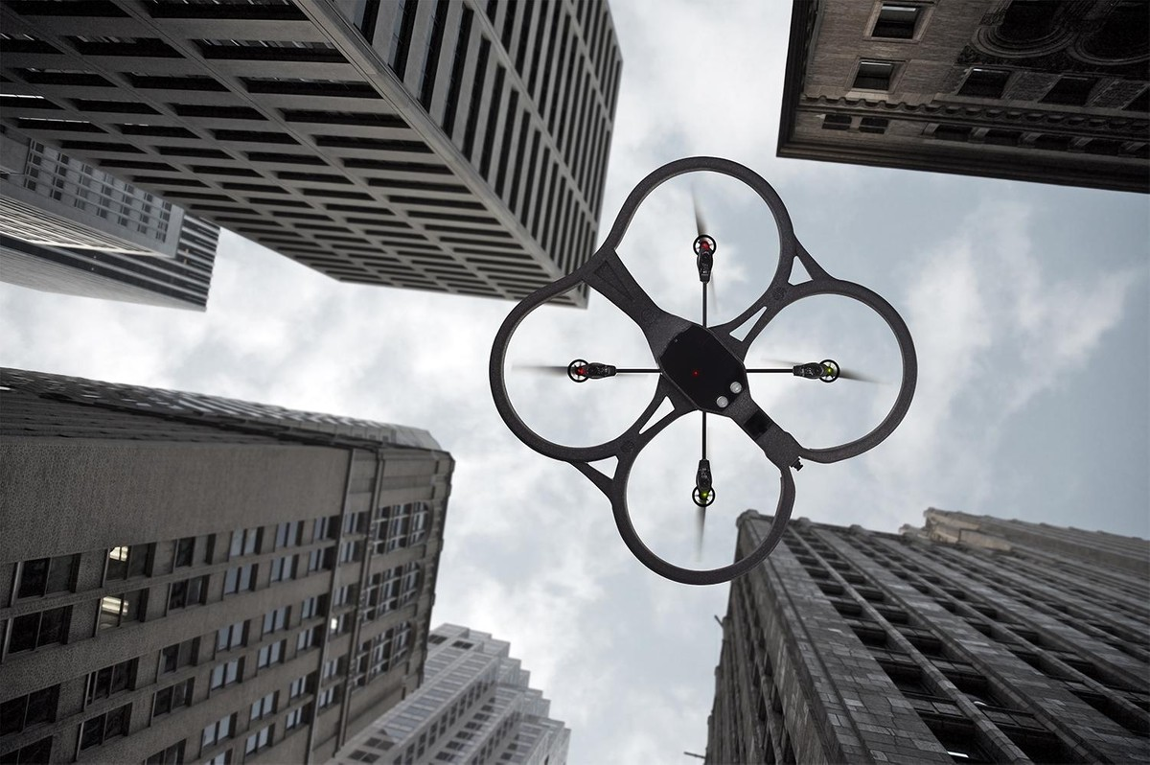
Introduction
Our product feature is Collision Avoidance with an autonomous UAV.
Our system is a simulation built on Unreal Engine 4 and Microsoft’s AirSim Simulator.
Purpose: To minimize danger to human operators while gathering data and offer a dependable simulation that minimizes cost.

Slide 3
Background
Benefits:
Safer for user to collect data
Test platform easier to maintain
Reduce cost of testing UAV
Goals:
Independent autonomous behavior
Dynamically react to the environment
Follow the FAA Right-of-Way Rules

Slide 4

Head-On Approach
Notes:
Represents the robustness of the swarm, useful for continued functioning through dangerous situations

Slide 5
Converging Aircraft

Slide 6
Overtaking Maneuver

Slide 7
Thank You

